Slide 1
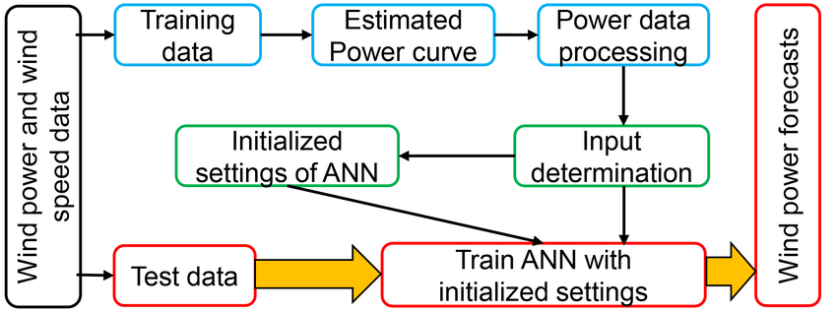


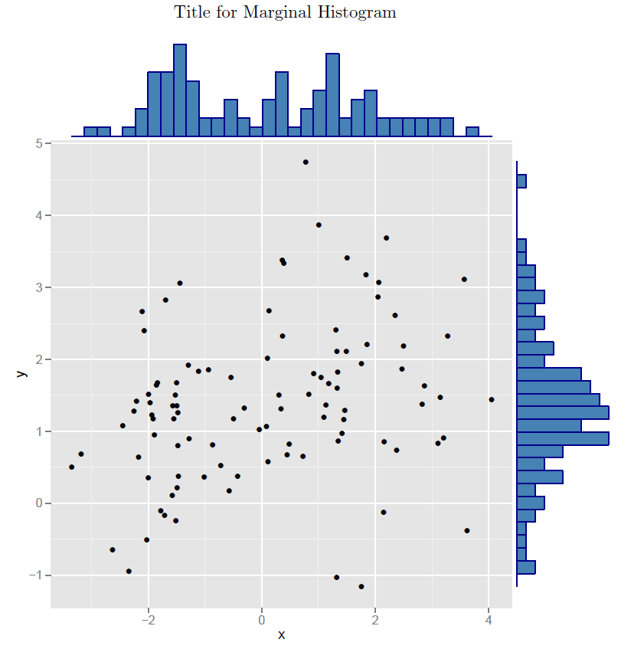


Rectify windmill and adapt techniques to increase output power
CUSTOMER JOURNEY MAP
Compare actual output power with estimated output power.
Produce estimated power curve
Information processing using machine learning.
Collecting site specific wind speed data.

